Slide 1


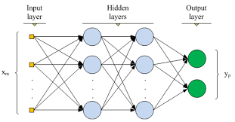
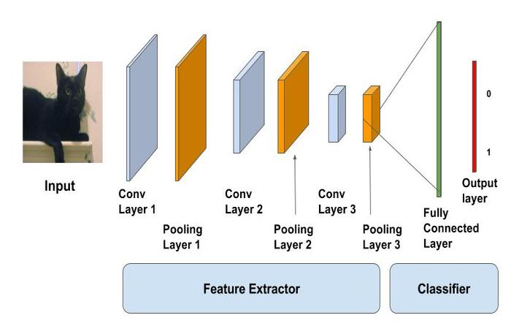
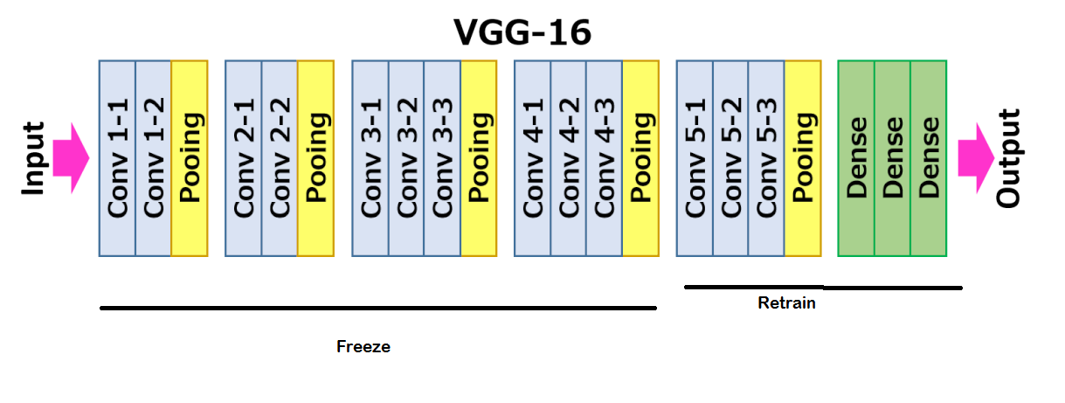

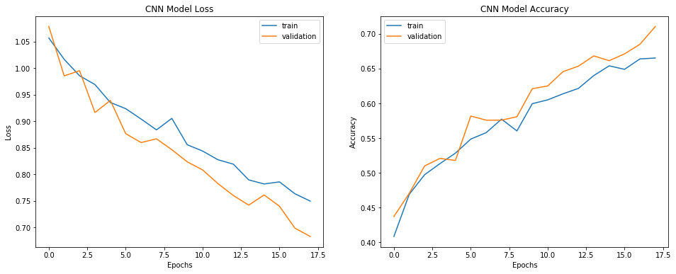
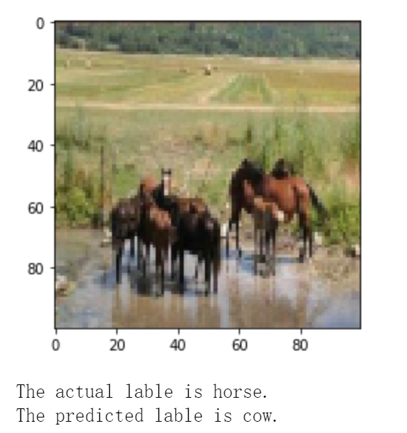
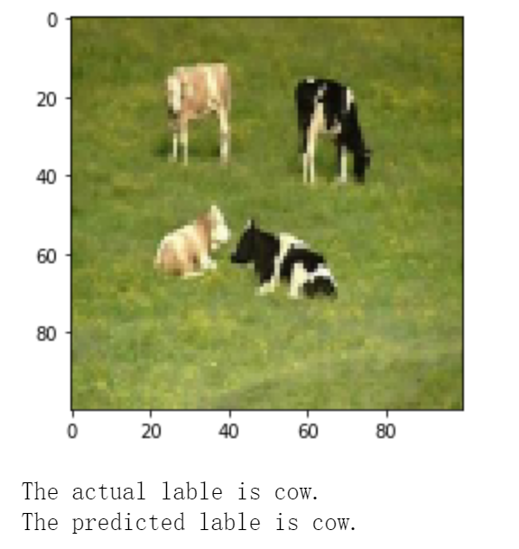
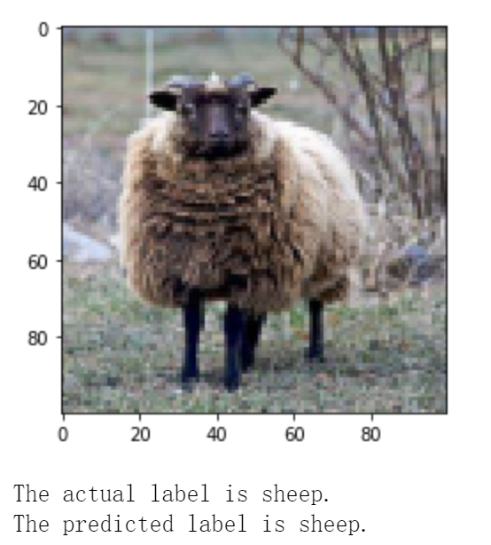
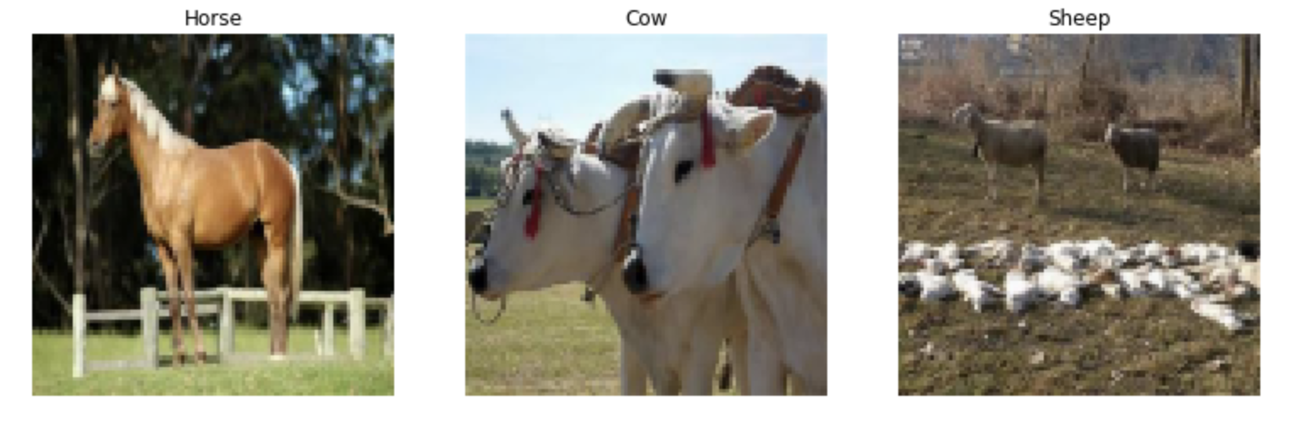
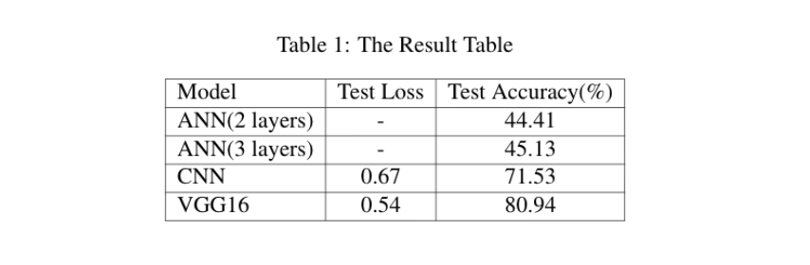
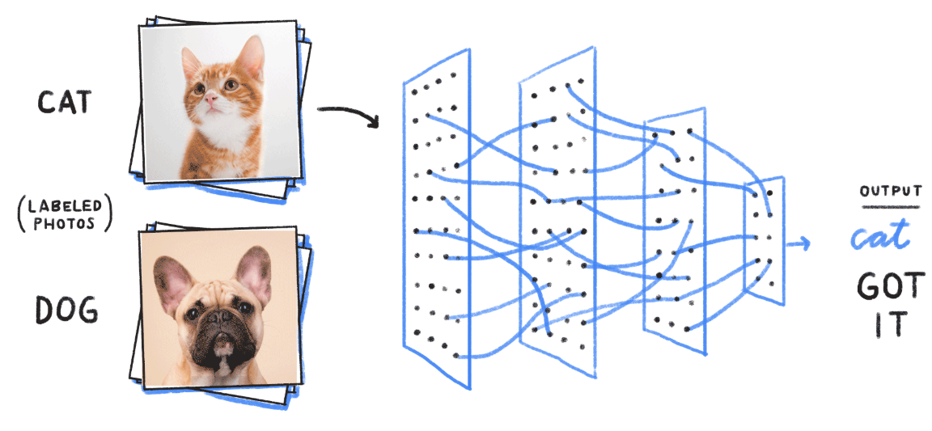
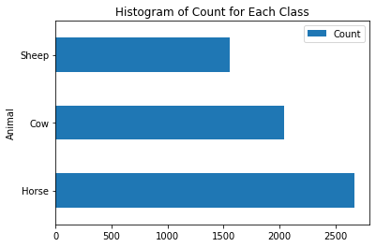
Animal Classification with ANN, CNN and VGG16
Hongyang Zheng, Heng Zhou, Zhengqian Xu, Youyou Xie
Georgetown University
ABSTRACT
RELATED WORKS
MODELS
With the rapid development in deep learning and neural networks, more powerful tools are introduced to deal with image problem. During this project, we use several methods to do animal classification. Our work begins with a brief introduction of object classification and related work. Then we introduce our dataset and how we preprocess and transform it. Next, we use three different methods to train our data and build model. Finally, performance of each model is provided and compared, which we can use for further analysis and conclusion.
Use neural networks to o classify huge amount of images in the ImageNet.
a) ANN Architecture
b) CNN Architecture
c) VGG16 Architecture
In 2014, Karen Simonyan and Andrew Zisserman from the Oxford Vision Geometry Group (VGG) achieved top results for image classification and localization with their VGG model.
QUANTITATIVE RESULTS
QUALITATIVE RESULTS
PROBLEM STATEMENT
Our project solves an image classification problem by applying some deep learning approaches. Image classification can be very useful in the following areas:
Classify the land usage type
Photo organization
Visual search
Our problem focuses on identifying and classifying animal species, which is a
Supervised Classification Problem
Input: Labelled animal image
Output: Animal type
Evaluation: Categorical cross entropy
Our overall architecture is like the below graph:
I
II
III
DATA
Animal-10 Dataset from Kaggle:
3 classes: Horse, Cow, Sheep
100 * 100 RGB median quality images
4000 train images
1016 validation images
1254 test images
 | Actual Label | Predicted Label
I | Horse | Cow
II | Cow | Cow
III | Sheep | Sheep
We found that this model would misclassify sheep as horse or horse as cow, because some of them have the same color and the images also have similar background (i.e., grass). It may perform better on other animals. Overall, our model is good.
Challenge:
Cow and Sheep are very similar to each other
Most animals have a close background (i.e. grass)
Imbalanced data
The accuracy for ANN is not very high and increasing the number of layers does not improve the model performance much.
For the CNN model, we tried 3 different training epochs. The best model has test accuracy 71% with18 epochs.
For VGG16, which performs best and agrees with our expectation. We tried 2 different training epochs. The best model has test accuracy 81% with 10 epochs
REFERENCES
[1] Jason Brownlee. Animal classification with vgg16 cnn, 2019.
[2] Jason Brownlee. A gentle introduction to the imagenet challenge (ilsvrc), 2019.
[3] Arthur Ouaknine. Review of deep learning algorithms for image classification, 2018.
[4] Zhong-Qiu Zhao, Peng Zheng, Shou-tao Xu, and Xindong Wu. Object detection with
deep learning: A review, 2018. cite arxiv:1807.055

